Slide 1
Social Web Analytics with hands on in R

Slide 2
In this session we are going to look
Introduction to Web Analytics of R
Installing Packages
Understanding Visitors
Which Pages are effective
How have visitors been visiting my website?
Pifalls

Slide 3
Key Performance Indicators and metrics
Page Views
Page analysis
Daily Unique Visitors
Top Exit Pages
Bounce Rates
Visitor Locations
Etc

Slide 4
Ways to prevent analysis Paralysis
Differentiate between small and large decisions
Focus on the results and metrics matters the most
Focus on small actions first
Simplify

Slide 5
Goals
Track, measure and analyze you website performance effectively using R
Get R capabailities and generate reports and visualizatoins

Slide 6
We are going to
Introduction to web analytics
Choosing R analytics
Using R
Installing R and R studio
Setting up google Analytics

Slide 7
Introduction to Web Analytics

Slide 8
What is web analytics
Why it is important
How it can help you to gain insights into the performance of your site

Slide 9


Slide 10
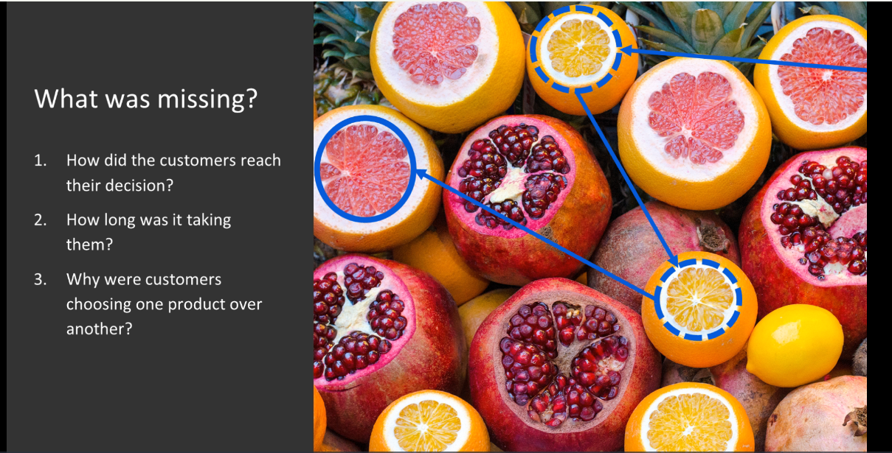

Slide 11


Slide 12


Slide 13
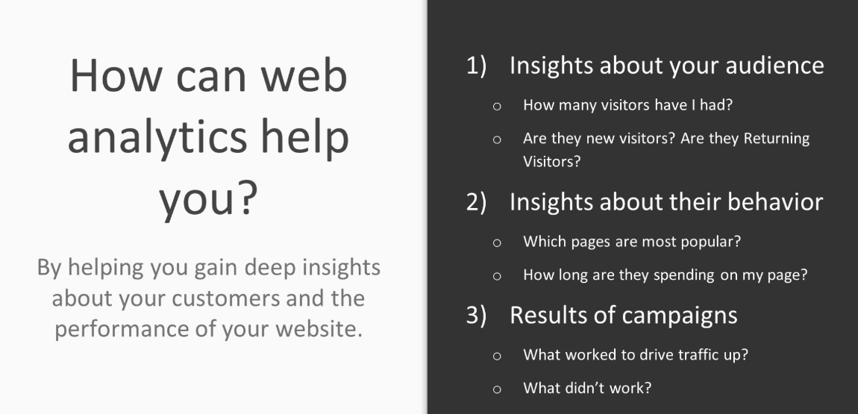

Slide 14
We will now see
What advantages Google Analytics have
Why Google Analytics is the most suited for your needs
Why Google Analytics is one of the most effective ways to add web analytics functionality to your websit

Slide 15


Slide 16
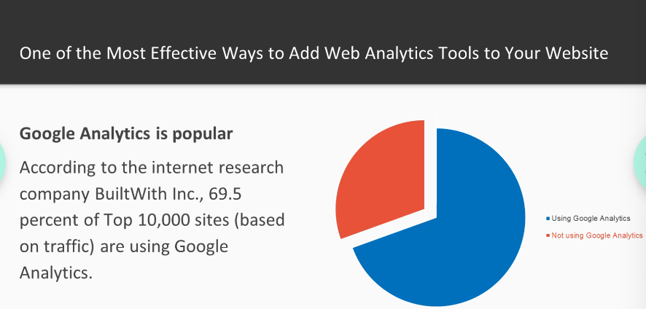

Slide 17


Slide 18


Slide 19
Installing R and Rstudio

Slide 20


Slide 21
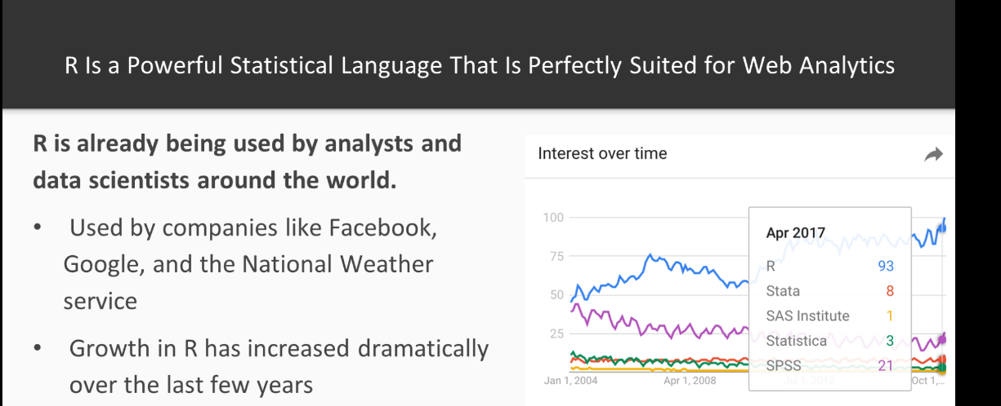

Slide 22


Slide 23
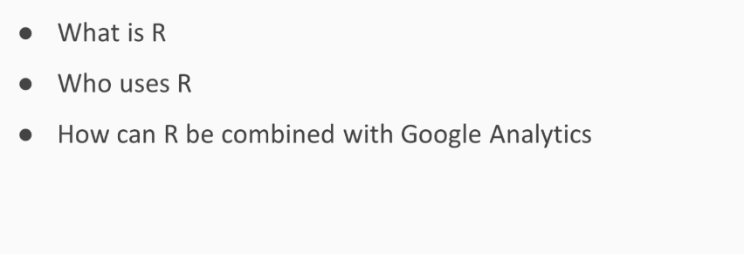

Slide 24


Slide 25
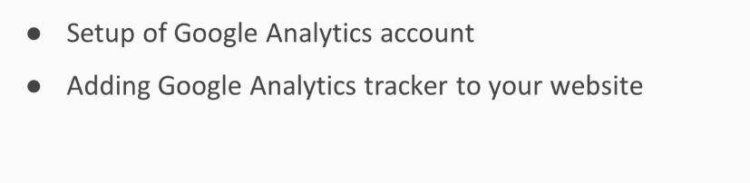

Slide 26
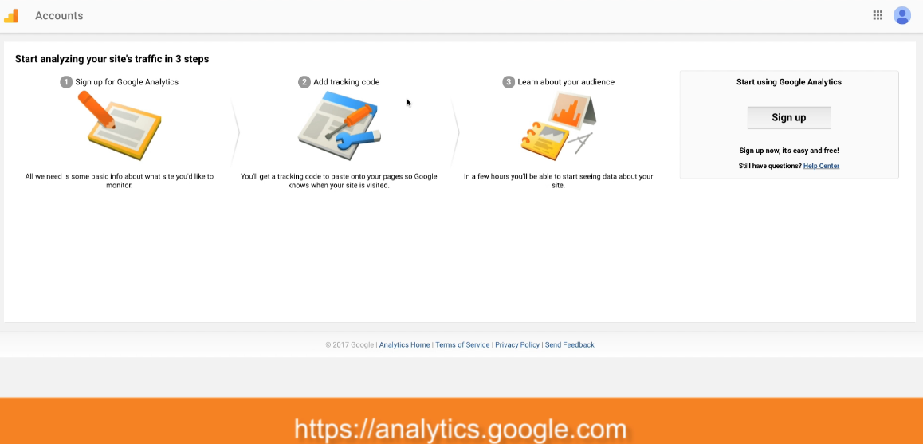

Slide 27
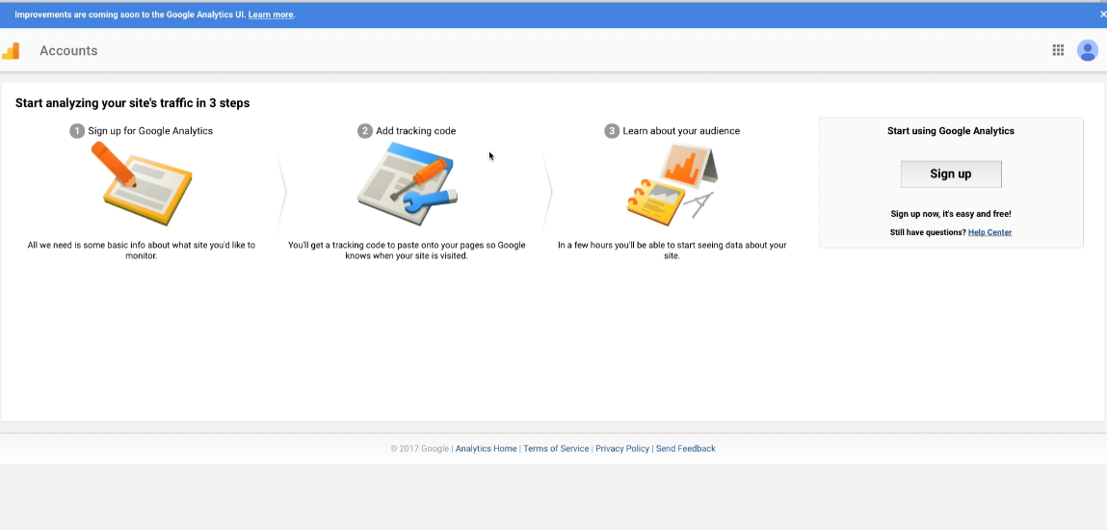

Slide 28
https://analytics.google.com

Slide 29


Slide 30
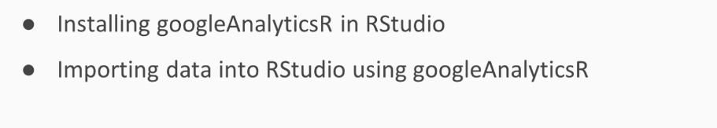

Slide 31


Slide 32
The datasets used in this project have been chosen from https://storage.googleapis.com/sample_user_behavior_data/sample_user_data.csv
Schema details can be found here: https://support.google.com/analytics/answer/3437719?hl=en

Slide 33
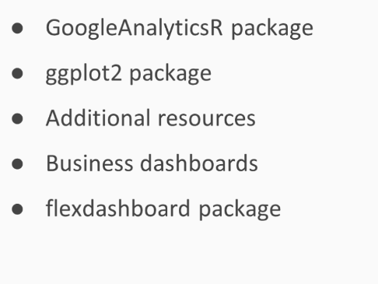

Slide 34
Install.packages(“googleAuthR”)
Install.packages(“oogleAnalyticsR”)
library("googleAuthR")
library("googleAnalyticsR")
ga_auth()
## get your accounts
account_list <- ga_account_list()
account_list$viewId
ga_id = 154893193
ga_data = google_analytics_4(ga_id, date_range = c("2024-06-11", "2024-07-1"), metrics = c(“sessions"), dimensions = c(“date"))

Slide 35
Installing gg plot2

Slide 36
#Install.packages(“googleAuthR”)
#Install.packages(“oogleAnalyticsR”)
Install.packages(“ggplot2”)
library("googleAuthR")
library("googleAnalyticsR")
Library(ggplot2”
ga_auth()
## get your accounts
account_list <- ga_account_list()
account_list$viewId
ga_id = 154893193
ga_data = google_analytics_4(ga_id, date_range = c("2024-06-11", "2024-07-1"), metrics = c(“sessions"), dimensions = c(“date"))

Slide 37
Great Source for ggplot2:
http://tutorials.iq.harvard.edu/R/Rgraphics/Rgraphics.html
Sources for googleAnalyticsR package:
https://michalbrys.gitbooks.io/r-google-analytics/content/
Google Analytics Metrics:
https://developers.google.com/analytics/devguides/reporting/core/dimsmets

Slide 38
Introduction to business dashboards
Introduction to R Markup Language
Setting up and adding information to analytics dashboard

Slide 39
Why use dashboards
One page overview of all your KPIs at a glance
Respond to changing conditions
Conduct your own anlaysis

Slide 40
Flexdashboard package
Use R Mardown to publish a group pf related visualizations as a dashboard
Integration with HTML widgets, graphics, tabular data and Shiny

Slide 41
Installed googleAnalyticsR package
Installed ggplot2
Imported Google Analytics data and generated our first plot
Introduced business dashboards and installation of flexdashboard package

Slide 42
In this Section, we are going to take a look at
Who are my visitors
Who is coming back
How loyal are they
Building business dashboard
What does it all mean

Slide 43
Who are the visitors to the site?

Slide 44
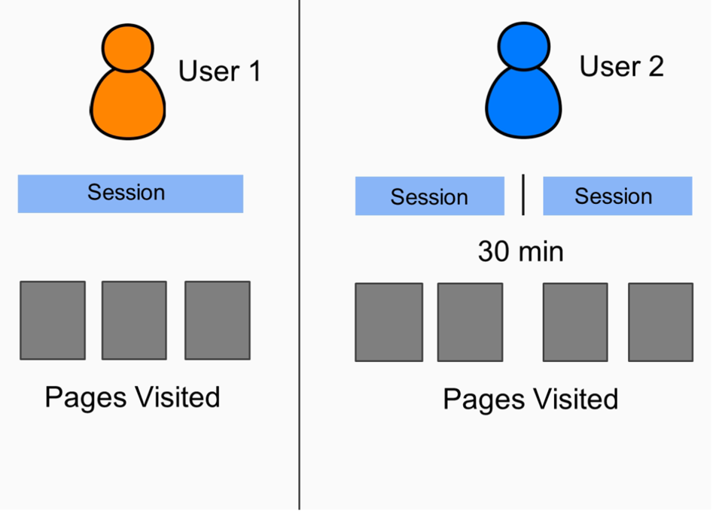
Sessions versus users
1. User is a specific visitor
2. Session is like a visit
3. One user can have multiple sessions

Slide 45
Who is coming back to our site?

Slide 46
Who is coming back to our site?
Who is returning to our site
How does Google distinguish a New Visitor from a Returning Visitor
How can we extract and plot New and Returning Visitor Data
What are some caveats to understanding New vs Returning Visitor counts

Slide 47
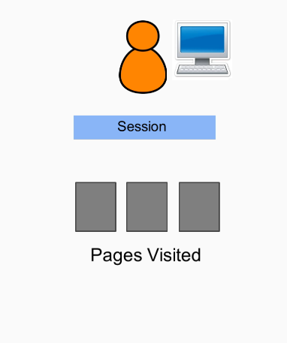
Who is coming back to our site?
Users visiting the page from different devices will be recorded as new visitors
Users who have deleted their cookies will be recorded as new visitors
Users who visit again after two years will be counted as new visitors

Slide 48
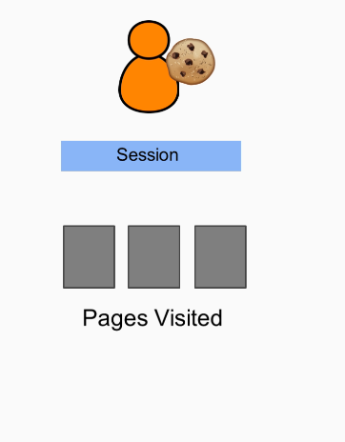
Who is coming back to our site?
Users visiting the page from different devices will be recorded as new visitors
Users who have deleted their cookies will be recorded as new visitors
Users who visit again after two years will be counted as new visitors

Slide 49
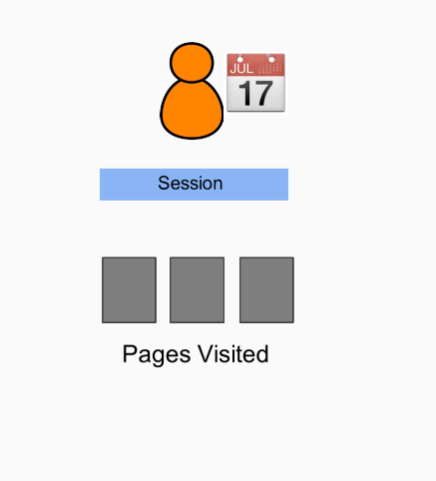
Who is coming back to our site?
Users visiting the page from different devices will be recorded as new visitors
Users who have deleted their cookies will be recorded as new visitors
Users who visit again after two years will be counted as new visitors

Slide 50
New Vs Return
library("googleAuthR")
library("googleAnalyticsR")
library("ggplot2")
#install.packages("scales")
library("scales")
## authenticate, or use the RStudio Addin "Google API Auth" with analytics scopes set
ga_auth()
## get your accounts
account_list <- ga_account_list()
account_list$viewId
ga_id = 154893193
# downloading Google API
ga_data = google_analytics_4(ga_id, date_range = c("2017-06-11", "2017-07-18"), metrics = c("ga:sessions"), dimensions = c("ga:userType"))

Slide 51
New Vs Return
# using example file
ga_data = read.csv("ExampleFile_3.2_NewvsReturning.csv", sep=",", header=T)
# cleaning up data
ga_data.toPlot = data.frame(userType=c("New Visitor", "Returning Visitor"), sessions = ga_data$Sessions)
ga_data.toPlot$sessions = as.numeric(gsub(",", "", ga_data.toPlot$sessions))
# percentage
ga_data.toPlot$percentage = ga_data.toPlot$sessions / sum(ga_data.toPlot$sessions)
ggplot(data=ga_data.toPlot, aes(x=userType, y=sessions, fill=userType)) +
geom_bar(width = 0.6, stat="identity") + geom_text(aes(y=sessions/2, label=scales::percent(percentage)), size=5)

Slide 52
How can you calculate visitor loyalty?
Not one "simple" way to measure loyalty
However, a number of metrics can be combined to gain insight into visitor loyalty
Returning Visitor Rate (RVR) is one of these metrics

Slide 53
library("googleAuthR")
library("googleAnalyticsR")
library("ggplot2")
library("scales")
## authenticate, or use the RStudio Addin "Google API Auth" with analytics scopes set
ga_auth()
## get your accounts
account_list <- ga_account_list()
account_list$viewId
## Use the viewId for your data
ga_id <- 154893193 # Replace with account_list$viewId[1] or any specific viewId
# downloading Google API data
ga_data = google_analytics_4(ga_id, date_range = c("2017-05-18", "2017-07-18"), metrics=c("ga:pageviews", "ga:users"), dimensions=c("ga:sessionCount"))
# using example file
ga_data = read.csv("ExampleFile_3.3_FrequencyRecency.csv", sep=",", header=T)
# cleaning up data
ga_data.toPlot = data.frame(ga_data)
ga_data.toPlot$Pageviews = as.numeric(gsub(",", "", ga_data.toPlot$Pageviews))
ga_data.toPlot$Users = as.numeric(gsub(",", "", ga_data.toPlot$Users))
# ordering data
ga_data.toPlot$Count.of.Sessions = factor(ga_data.toPlot$Count.of.Sessions, levels = ga_data.toPlot$Count.of.Sessions)
# generate plot
ggplot(ga_data.toPlot, aes(x=Count.of.Sessions, y=Pageviews)) + geom_bar(stat="identity", width = 0.8, fill="tomato3")

Slide 54
Adding plots to dashboard
Interpreting results and recommended actions
Additional resources

Slide 55
---
title: "Visitor Recency and Loyalty"
output:
flexdashboard::flex_dashboard:
orientation: rows
vertical_layout: fill
---
```{r setup, include=FALSE}
library(flexdashboard)
library("googleAuthR")
library("googleAnalyticsR")
library("ggplot2")
library("scales")

Slide 56
ga_data = read.csv("ExampleFile_3.2_NewvsReturning.csv", sep=",", header=T)
# cleaning up data
ga_data.toPlot = data.frame(userType = c("New Visitor", "Returning Visitor"), sessions = ga_data$Users[1:2])
ga_data.toPlot$sessions = as.numeric(gsub(",", "", ga_data.toPlot$sessions))
# add as percentage
ga_data.toPlot$percentage = ga_data.toPlot$sessions / sum(ga_data.toPlot$sessions)
# naming something consistent
toPlot.NewvsReturningVisitors = ga_data.toPlot

Slide 57
ga_data = read.csv("ExampleFile_3.2_NewvsReturning.csv", sep=",", header=T)
# cleaning up data
ga_data.toPlot = data.frame(userType = c("New Visitor", "Returning Visitor"), sessions = ga_data$Users[1:2])
ga_data.toPlot$sessions = as.numeric(gsub(",", "", ga_data.toPlot$sessions))
# add as percentage
ga_data.toPlot$percentage = ga_data.toPlot$sessions / sum(ga_data.toPlot$sessions)
# naming something consistent
toPlot.NewvsReturningVisitors = ga_data.toPlot

Slide 58
# using example file
ga_data = read.csv("ExampleFile_3.3_FrequencyRecency.csv", sep=",", header=T)
# making sure our axis show up correctly
CountOfSessions = rev(ga_data$Count.of.Sessions)
ga_data$Count.of.Sessions = factor(ga_data$Count.of.Sessions, levels = CountOfSessions)
ga_data$Users = as.numeric(gsub(",", "", ga_data$Users))
# calculate percentage
ga_data$UsersPercentage = ga_data$Users / sum(ga_data$Users)
toPlot.PagesPerUser = ga_data

Slide 59
theme_set(theme_bw())
ggplot(toPlot.NewvsReturningVisitors, aes(x=userType, y=sessions, fill=userType)) +
geom_bar(width = 0.6, stat="identity") +
geom_text(aes(y = sessions/2, label = scales::percent(percentage)), size=5) +
labs(title="Visitor Plot", subtitle="New Vs Returning Visitors") +
ylab("Number of Visitors") +
scale_y_continuous(breaks=seq(0,15000,1000))

Slide 60
# Draw plot
ggplot(toPlot.PagesPerUser, aes(x=Count.of.Sessions, y=Users)) +
geom_bar(stat="identity", width=0.8, fill="tomato3") +
coord_flip() +
geom_text(aes(y = Users, label = scales::percent(UsersPercentage)), hjust = -0.1) +
scale_y_continuous(breaks = seq(0, 110000, 20000), limits = c(0, 110000), labels = scales::comma) +
ylab("Number of Sessions") +
xlab("Number of Users") +
labs(title="Loyalty plot", subtitle="Number of Sessions per User") +
theme(axis.text.x = element_text(angle=45, vjust=0.6))

Slide 61
This RMarkdown file includes the setup, data loading, cleaning, plotting for both "New vs Returning Visitors" and "Pages Per User," and additional sections for further insights and resources.

Slide 62
How a web session is defined
https://support.google.com/analytics/answer/2731565?hl=en
Google Analytics Query Explorer
https://ga-dev-tools.appspot.com/query-explorer/
Google Analytics Metrics and Dimensions Explorer
https://developers.google.com/analytics/devguides/reporting/core/dimsmets

Slide 63
tep 1: Enable Google Analytics API
Go to the Google Cloud Console: Google Cloud Console
Create a new project or select an existing project.
Enable the Google Analytics API:
Navigate to APIs & Services > Library.
Search for "Google Analytics API".
Click on the "Google Analytics API" and enable it.
Step 2: Set Up OAuth Consent Screen
Configure OAuth Consent Screen:
Navigate to APIs & Services > OAuth consent screen.
Choose External or Internal based on your requirements.
Fill in the required fields, including Application Name, Support Email, and Authorized Domains.
Save and continue through the rest of the steps.
Step 3: Create OAuth Credentials
Create OAuth 2.0 Client IDs:
Navigate to APIs & Services > Credentials.
Click on Create Credentials and select OAuth 2.0 Client IDs.
Select Web application and fill in the required fields:
Name: Provide a name for your client ID.
Authorized redirect URIs: Add http://localhost:1410/ (this is the default redirect URI used by googleAuthR).
Obtain Client ID and Client Secret:
Once created, you will see your Client ID and Client Secret. Note these down.
Step 4: Use Your OAuth Credentials in R
Set the OAuth Credentials in R:
r
library(googleAnalyticsR) library(googleAuthR) # Replace with your actual client ID and client secret client_id <- "your_client_id" client_secret <- "your_client_secret" # Set the Google Analytics authentication scope options(googleAuthR.scopes.selected = "https://www.googleapis.com/auth/analytics.readonly") # Set the client ID and client secret options(googleAuthR.client_id = client_id) options(googleAuthR.client_secret = client_secret) # Clear any existing tokens googleAuthR::gar_deauth() # Authenticate with Google Analytics ga_auth()

Slide 64
Summary
Website visits are measured using users and sessions
Users are like visitors and sessions are like visits
RVR can be used to see how many people are coming back to our site
A low new visitor rate may be improved by additional marketing

Slide 65
Which Pages Have the Highest Exit and Bounce Rates?

Slide 66
Extracting Exit and Bounce Rate data
Plotting "Biggest-Loser" table (pages with highest exit and bounce rates)

Slide 67
# Load required libraries
library("googleAuthR")
library("googleAnalyticsR")
library("ggplot2")
library("scales")
# Authentication
ga_auth()
# Get our accounts
account_list = ga_account_list()
account_list$viewId
ga_id <- 154893193
# Download from Google API
ga_data = google_analytics_4(ga_id, date_range=c("2017-06-11", "2017-06-18"),
metrics = c("ga:exitRate", "ga:pageviews", "ga:bounceRate"),
dimensions=c("ga:pagePath"))
# Example data
ga_data = read.csv("ExampleFile_4.2_ViewPages.csv", sep=",", header=T)
ga_data.toPlot = data.frame(ga_data)
# Cleaning up ordering
ga_data.toPlot$Page = factor(ga_data.toPlot$Page, levels = rev(ga_data.toPlot$Page))
# Plot Bounce Rate
ggplot(ga_data.toPlot, aes(x=Page, y=Bounce.Rate)) +
coord_flip() +
geom_bar(fill="cornflowerblue", stat="identity", width=0.8, show.legend=FALSE) +
ylim(0, 1.0)
# Plot Exit Rate
ggplot(ga_data.toPlot, aes(x=Page, y=Exit.Rate)) +
coord_flip() +
geom_bar(fill="tomato3", stat="identity", width=0.8, show.legend=FALSE) +
ylim(0, 1.0)

Slide 68
EXIT RATE VS BOUNCE RATE

Slide 69
Which pages are effective?
Which pages work the best
Biggest Loser Table
Combining plots into dashboard
Can we do better

Slide 70
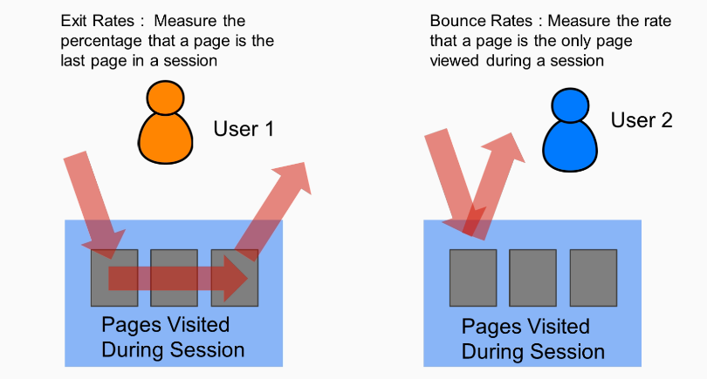
Which pages are effective?

Slide 71
Is a high Exit Rate always bad? No.

Slide 72
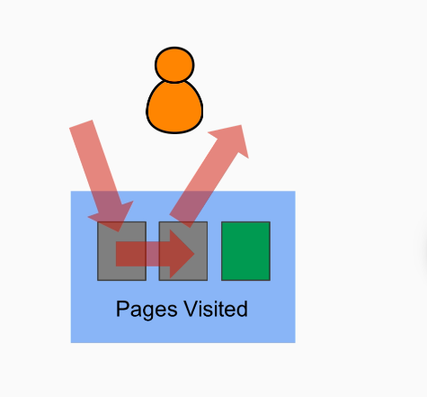
Exit Rates
Measure the percentage of visitors who click away to a different site from a specific pageHigh exit rate can be part of the flow or natural process, like end of a content series or checkout process

Slide 73
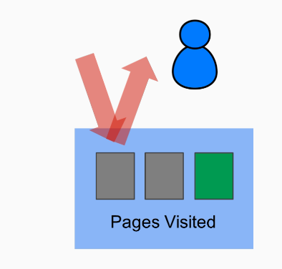
Bounce Rates measure single page visits
A "bounce" means a user came to your site, and left without doing anything else
A high bounce rate on a home page is usually a sign that something is wrong

Slide 74
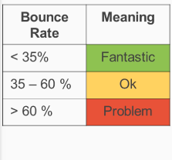
Bounce Rates measure single page visits
A "bounce" means a user came to your site, and left without doing anything else
A high bounce rate on a home page is usually a sign that something is wrong

Slide 75
How Can High Bounce Rates Be Improved?

Slide 76
Ways to Improve Bounce Rate
3. Decrease load times
4. Improve design
Focus only on essential components
Limit color scheme
Simplify navigation
Simplify, simplify, simplify!
Analyze where the current problem is coming from
Optimize thought sequences
Where am I
What can I do
How do I get started

Slide 77
Avinash Kaushik’s Write-up on Bounce Rate
https://www.kaushik.net/avinash/standard-metrics-revisited-3-bounce-rate/
Other suggestions for improving Bounce Rate
https://www.ventureharbour.com/reduce-bounce-rate/
https://support.google.com/analytics/answer/1009409?hl=en

Slide 78
Looking Back: How Have Visitors Been Visiting My Website?

Slide 79
Multiple time-frames
Why is context important
Looking back - how has my site been doing over the last 2 years
Combining plots into dashboard
What does it all mean

Slide 80
What is the importance of multiple time-frame analysis
What will you miss by looking only at single-time frames
What insights can you gain from looking at yearly, weekly, and daily charts

Slide 81
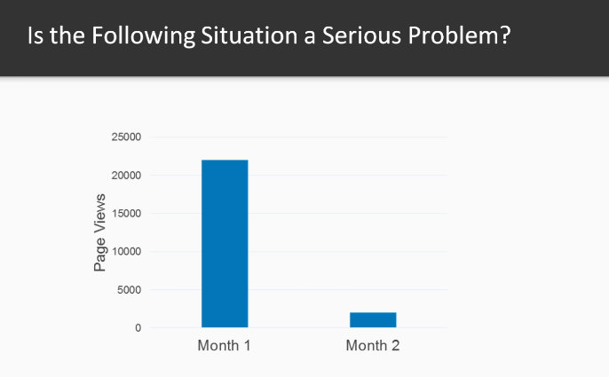

Slide 82
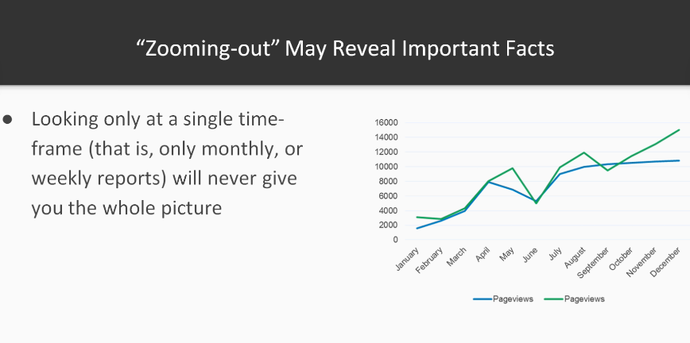

Slide 83
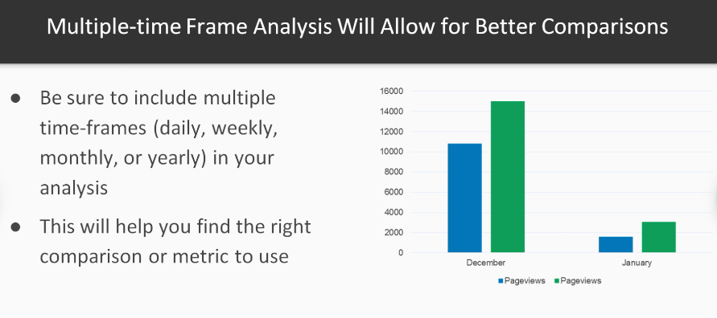

Slide 84
Why is context important?
What is context and why is it essential for interpreting metrics correctly
What mistakes can you make if you ignore context
How you can place your metrics in the correct context

Slide 85
Pageviews=10000

Slide 86
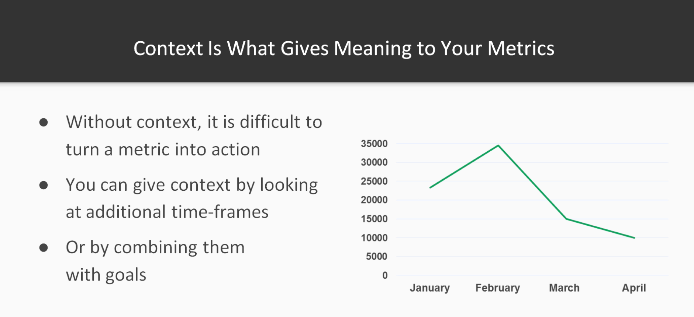

Slide 87
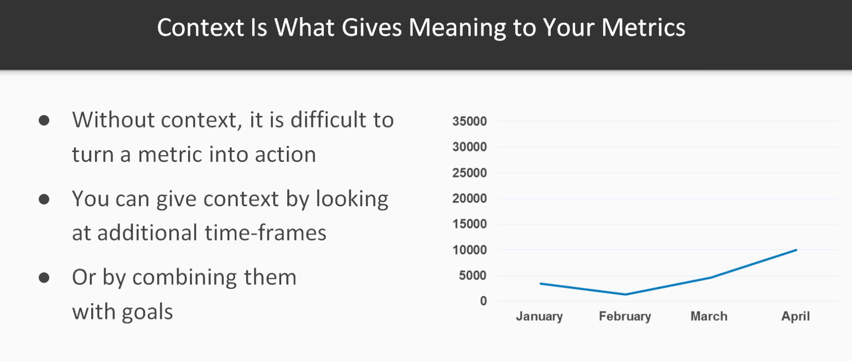

Slide 88
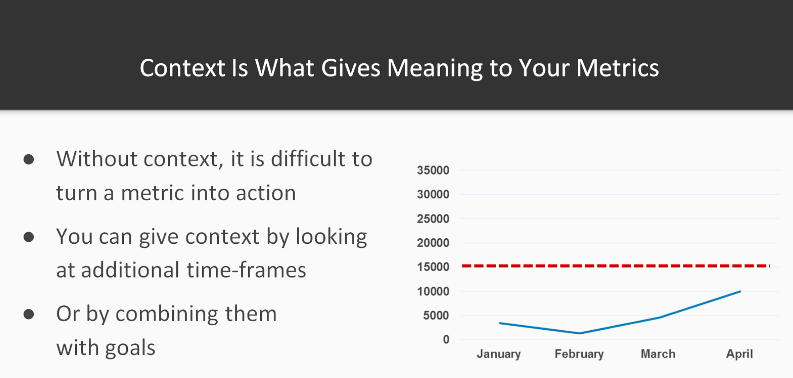

Slide 89
Building Business Dashboard

Slide 90
Adding plots to business dashboard
What can the results be interpreted
What are our problem areas

Slide 91
# How about the other one?
ga_data.2016 = read.csv("ExampleFile_5.3_DateSessions_2016.csv", sep=",", header=T, as.is=T)
ga_data.2017 = read.csv("ExampleFile_5.3_DateSessions_2017.csv", sep=",", header=T, as.is=T)
# filter
temp_ga_data = data.frame(date = as.Date(ga_data.2017$date), sessions1 = ga_data.2016$sessions, sessions2 = ga_data.2017$sessions)
temp_ga_data.long = melt(temp_ga_data, id="date")
# Adding to the variable
DataToPlot.PageViews = temp_ga_data.long

Slide 92
---
title: "Website Performance (2016 vs 2017)"
output:
flexdashboard::flex_dashboard:
storyboard: true
---
```{r setup, include=FALSE}
library(flexdashboard)
library(googleAuthR)
library(googleAnalyticsR)
library(ggplot2)
library(scales)
library(reshape)

Slide 93
# How about the other one?
ga_data = read.csv("ExampleFile_5.3_NewvsReturning_2017.csv", sep=",", header=T)
# cleaning up data
ga_data.toPlot.2017 = data.frame(userType=c("New Visitor", "Returning Visitor"), sessions = ga_data$Sessions)
ga_data.toPlot.2017$sessions = as.numeric(gsub(",", "", ga_data.toPlot.2017$sessions))
# percentage
ga_data.toPlot.2017$percentage = ga_data.toPlot.2017$sessions / sum(ga_data.toPlot.2017$sessions)
ga_data.toPlot.2017$year = c("2017", "2017")

Slide 94
# How about the other one?
ga_data = read.csv("ExampleFile_5.3_NewvsReturning_2016.csv", sep=",", header=T)
# cleaning up data
ga_data.toPlot.2016 = data.frame(userType=c("New Visitor", "Returning Visitor"), sessions = ga_data$Sessions)
ga_data.toPlot.2016$sessions = as.numeric(gsub(",", "", ga_data.toPlot.2016$sessions))
# percentage
ga_data.toPlot.2016$percentage = ga_data.toPlot.2016$sessions / sum(ga_data.toPlot.2016$sessions)
ga_data.toPlot.2016$year = c("2016", "2016")
# combining
DataToPlot.NewReturning = rbind(ga_data.toPlot.2016, ga_data.toPlot.2017)

Slide 95
# Exit Pages
ga_data = read.csv("ExampleFile_5.3_ViewPages_2017.csv", sep=",", header=T)
# turn into data.frame
ga_data.toPlot.2017 = data.frame(ga_data)
ga_data.toPlot.2017$Page = factor(ga_data.toPlot.2017$Page, levels=rev(ga_data.toPlot.2017$Page))
ga_data = read.csv("ExampleFile_5.3_ViewPages_2016.csv", sep=",", header=T)
ga_data.toPlot.2016 = data.frame(ga_data)
ga_data.toPlot.2016$Page = factor(ga_data.toPlot.2016$Page, levels=rev(ga_data.toPlot.2016$Page))
BounceExit.2016 = ga_data.toPlot.2016
BounceExit.2017 = ga_data.toPlot.2017

Slide 96
ggplot(DataToPlot.PageViews, aes(x=date, y = value, color=variable)) + geom_line() +
xlab("Month") + ylab("Daily Views") +
scale_color_discrete(name = "Sessions", labels = c("2016", "2017"))
ggplot(DataToPlot.NewReturning, aes(x=userType, y=sessions)) +
geom_bar(aes(fill=year), width=0.6,position="dodge", stat="identity") +
geom_text(aes(y=sessions/2, fill=year, label=percent(percentage)), position=position_dodge(width=0.6), size=4)
ggplot(BounceExit.2016, aes(x=Page,y=Exit.Rate)) + coord_flip() +
geom_bar(fill="#ef3b2c", width=0.8, stat="identity", show.legend = FALSE) +
geom_text(aes(y = Exit.Rate, label = percent(Exit.Rate)), hjust = -0.1) + ylim(0,1.0) + geom_hline(yintercept = 0.5, linetype="dashed") + xlab("Page Path") + ylab("Exit Rate")

Slide 97
ggplot(BounceExit.2017, aes(x=Page,y=Exit.Rate)) + coord_flip() +
geom_bar(fill="#9900d", width=0.8, stat="identity", show.legend = FALSE) +
geom_text(aes(y = Exit.Rate, label = percent(Exit.Rate)), hjust = -0.1) + ylim(0,1.0) + geom_hline(yintercept = 0.5, linetype="dashed") + xlab("Page Path") + ylab("Exit Rate")

Slide 98
Additional Resources
Flexdashboard Examples
http://rmarkdown.rstudio.com/flexdashboard/examples.html
Color Brewer for plotting
http://colorbrewer2.org/#type=sequential&scheme=BuGn&n=3

